Slide 1

STREET FIGHTER
Supervisor : Prof. Tahseen Mulla
Presented By
VU1F2223066 : Aaryan Nalawade
VU1F2223079 : Prathamesh Jadhav
VU1F2223083 : Harshit Upadhyay

Slide 2
Contents
Introduction to python and pygame
Introduction to Street Fighter
Game Mechanics
Controls
Challenges Faced
Screenshots
Conclusion

Slide 3
1] Introduction
Overview
In Python game development for Street Fighter, one would typically utilize libraries like Pygame or Arcade. Pygame offers functionality for handling graphics, input, and sound, while Arcade provides additional features like physics simulations.
Developers would create characters, implement fighting mechanics, and design stages using object-oriented programming principles.
Collision detection, animation, and player input handling are crucial components.
Game loop management and event handling ensure smooth gameplay and multiplayer capabilities can also be implemented.
Testing and iteration are essential for refining gameplay mechanics and ensuring an enjoyable player experience.

Slide 4
Problem Statement
Design and implement a simplified version of the classic arcade game "Street Fighter" using Python for beginners. The game should feature basic functionalities such as player movement, health management, and basic attacks. The goal is to create an interactive and enjoyable game experience for users while providing them with an introduction to game development concepts and Python programming.

Slide 5
Objectives
1. Introduction to Python Programming: The primary objective of the project is to introduce novice programmers to Python programming by providing t hem with a practical learning experience. Through the development of a simplified "Street Fighter" game, participants will gain familiarity with Python syntax, data structures, and programming concepts such as variables, conditionals, loops, functions, and object-oriented programming (OOP) principles.
2. Basic Game Development Skills: Another key objective is to acquaint learners with the fundamental principles of game development. By guiding the m through the implementation of essential game functionalities like player movement, enemy AI, health management, and basic combat mechanics, the e project aims to instill a foundational understanding of game logic, design, and programming techniques.
3. Empowerment Through Project Completion: The project aims to empower participants by enabling them to complete a functional prototype of the "St reet Fighter" game. By providing step-by-step guidance, explanatory notes, and code examples, learners will gain the confidence and satisfaction of successfully designing and implementing a game from scratch. This accomplishment serves as a tangible demonstration of their newfound programming skills and lays the groundwork for further exploration in game development or other software engineering domains.

Slide 6
Introduction To Pygame
Pygame, a popular Python library for game development, empowers creators to bring their gaming visions to life with ease. Combining simplicity with versatility, Pygame provides a robust framework for designing 2D games, from classic arcade-style adventures to modern indie masterpieces. With its intuitive interface and extensive documentation.
Pygame offers a welcoming entry point for both novice and experienced developers alike.
Pygame's combination of ease of use, cross-platform compatibility, multimedia support, and community resources makes it a versatile and powerful framework for game development in Python.

Slide 7
2]Introduction to Street Fighter
Street Fighter is a classic fighting game that involves two players controlling the characters that engage in combat using various moves and tactics.
Brief History:
Street Fighter is a seminal fighting game franchise developed by Capcom.
Originated in arcades in 1987 with the release of the first Street Fighter game.
Pioneered the one-on-one fighting game genre, setting the standard for future titles.
Evolution of Gameplay:
Introduce iconic gameplay elements such as special moves, combos, and health bars.
Discuss the evolution of gameplay mechanics across different iterations of the series.

Slide 8
2]Introduction to Street Fighter
Cultural Impact:
Street Fighter has had a profound influence on gaming culture worldwide.
Popularized competitive gaming and arcade culture.
Iconic characters like Ryu, Chun-Li, and Ken have become cultural icons.
Legacy:
Street Fighter remains one of the most beloved and enduring franchises in gaming history.
Continues to inspire sequels, spin-offs, merchandise, and even movies and television adaptations.
Significance in Gaming Culture:
Discuss the game's impact on the fighting game community, esports, and the broader gaming industry.
Highlight the enduring appeal of Street Fighter among players of all ages and backgrounds.

Slide 9
3] Game Mechanics
Health Bars: Each player has a health bar that decreases as they take damage from their opponent's attacks. The player whose health bar is fully depleted loses the round.
Movement Controls: Players can move their characters left and right across the fighting arena and can also jump to avoid attacks or to initiate aerial attacks.
Basic Attacks: Players can perform basic attacks such as punches, kicks, and throws using different combinations of keyboard or controller inputs.
Round System: Matches are divided into rounds, with each round ending when one player's health bar is fully depleted. The first player to win a set number of rounds (usually best out of three) wins the match.

Slide 10
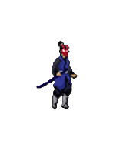
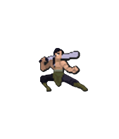
4] Controls
D: Move Right
W: Jump
A:Move Left
Q:Attack 1
E:Attack 2
4: Move Right
8: Jump
6:Move Left
7: Attack 1
9: Attack 2

Slide 11
5] Challenges Faced
Graphics and Animation: Implementing smooth graphics and animations for characters, moves, and backgrounds can be complex, especially in a text-based environment like Python.
Input Handling: Managing user input for controls, such as keyboard or gamepad inputs, and translating them into character movements and actions requires careful handling.
Collision Detection: Ensuring accurate collision detection between characters and objects, like punches, kicks, and walls, is crucial for gameplay realism.
Game Mechanics: Balancing the gameplay mechanics, such as health, stamina, special moves, and combos, to provide an enjoyable gaming experience can be challenging.
Sound and Music: Integrating sound effects and background music to enhance the gaming experience requires additional coding and resource management. User Interface: Designing and implementing menus, health bars, scoreboards.
Testing and Debugging: Identifying and fixing bugs, glitches, and performance issues throughout the development process can be time-consuming and challenging.

Slide 12
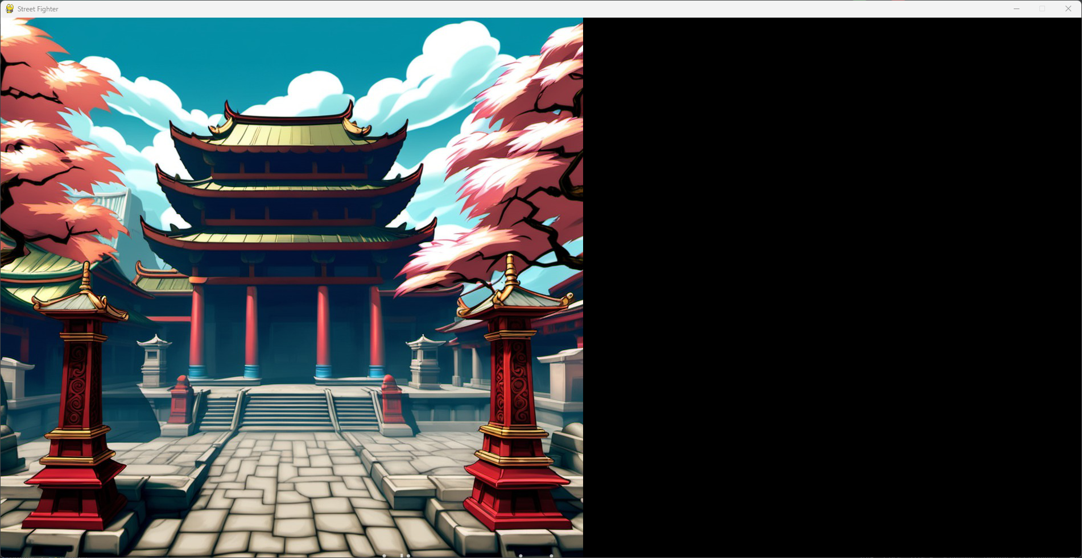
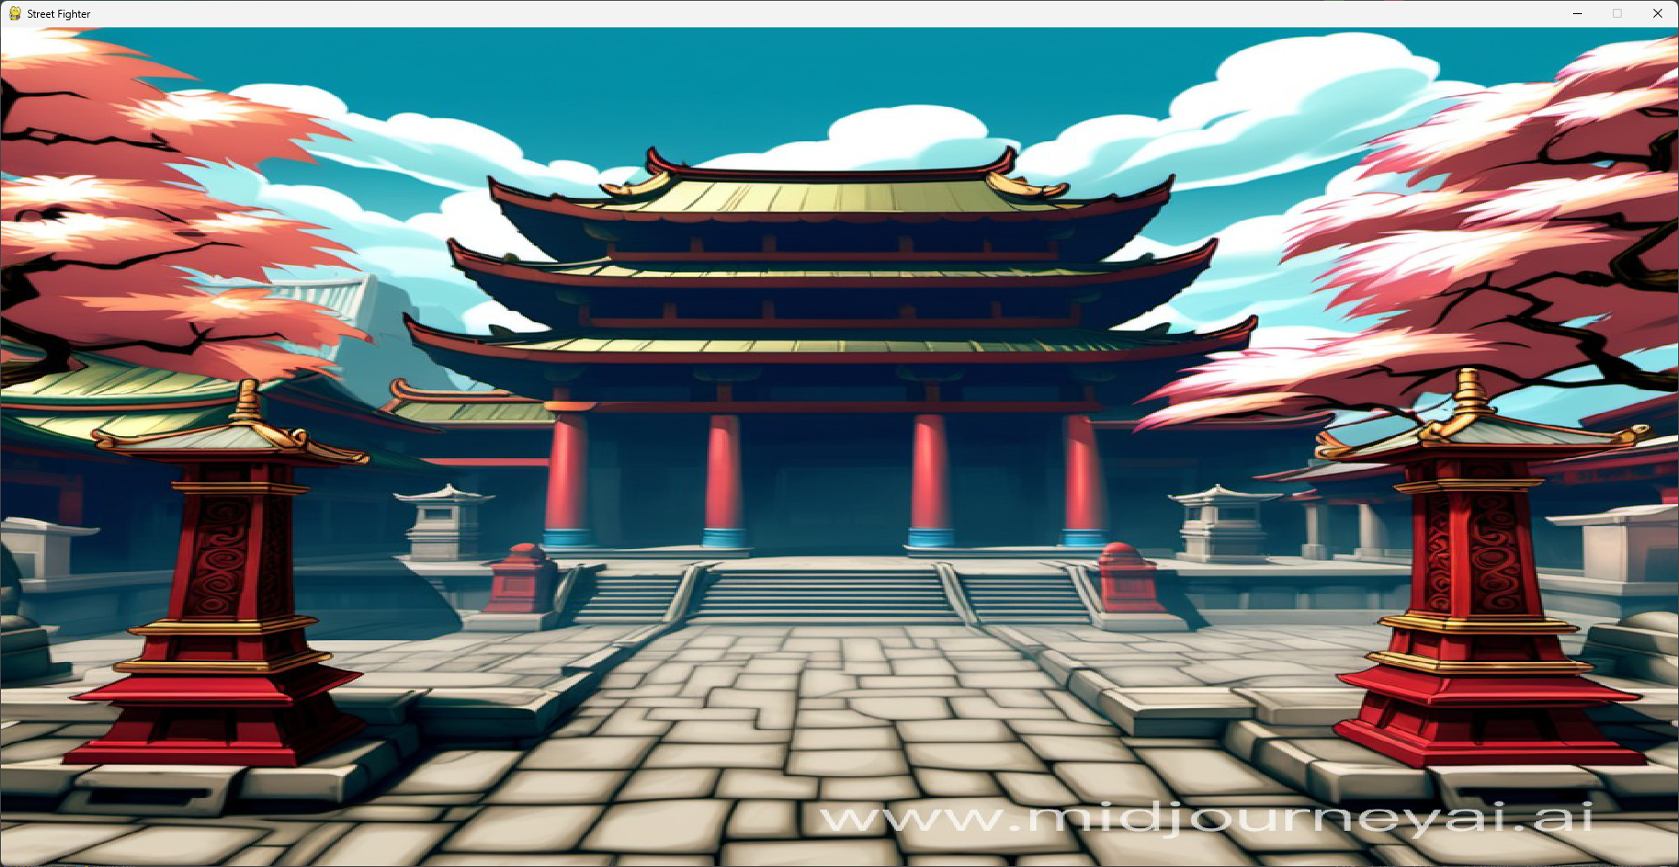
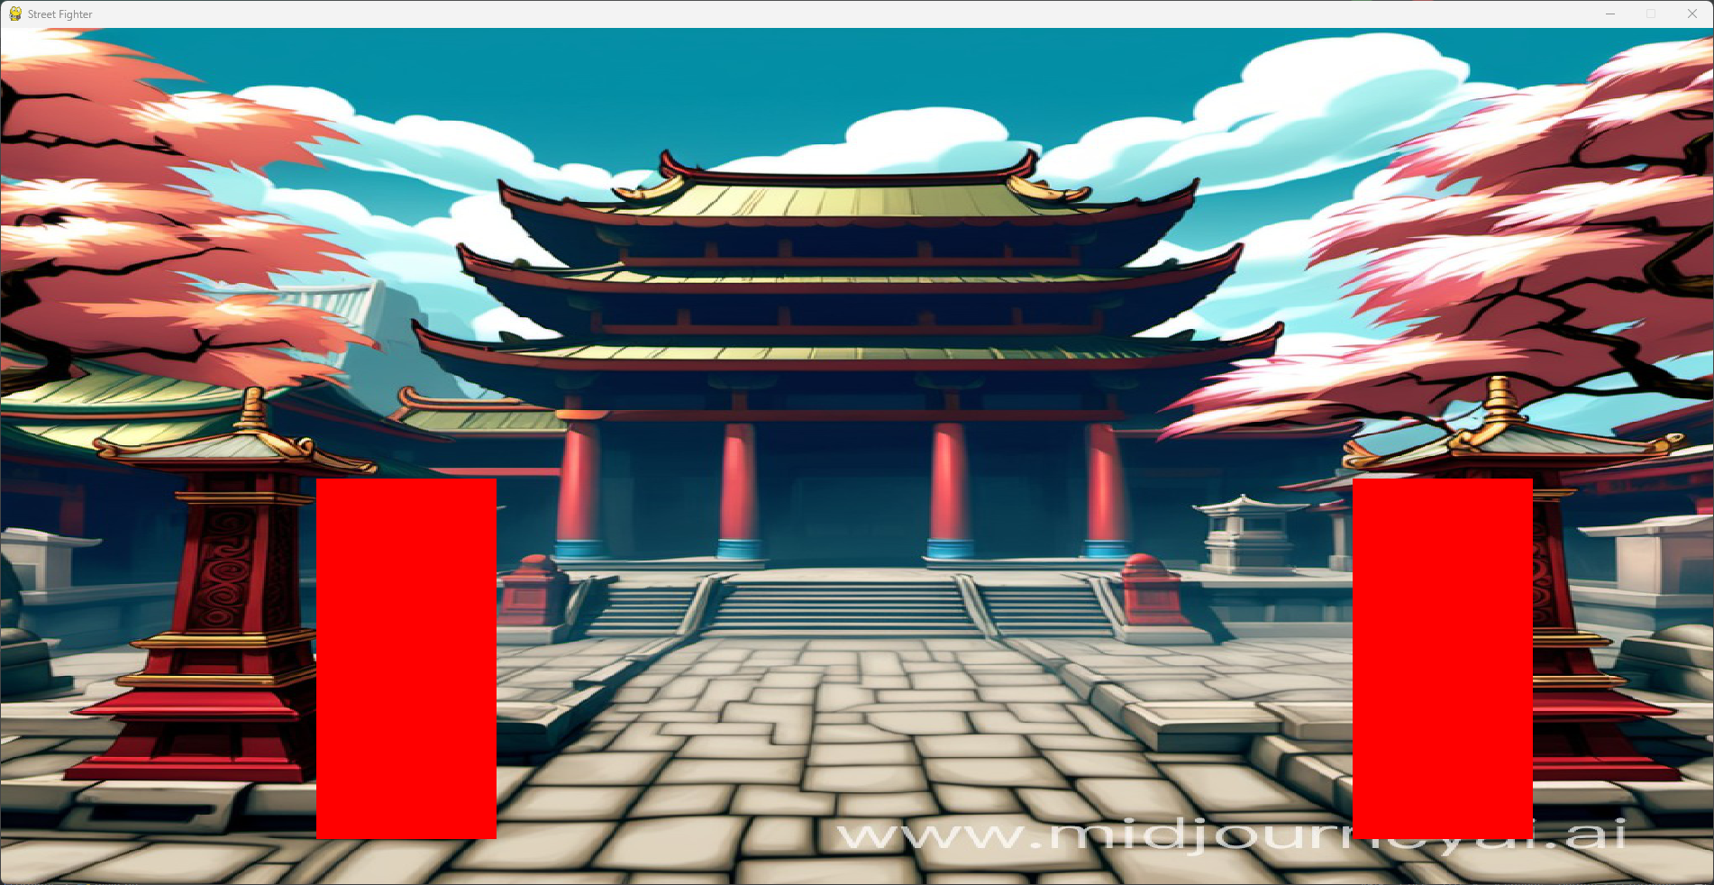
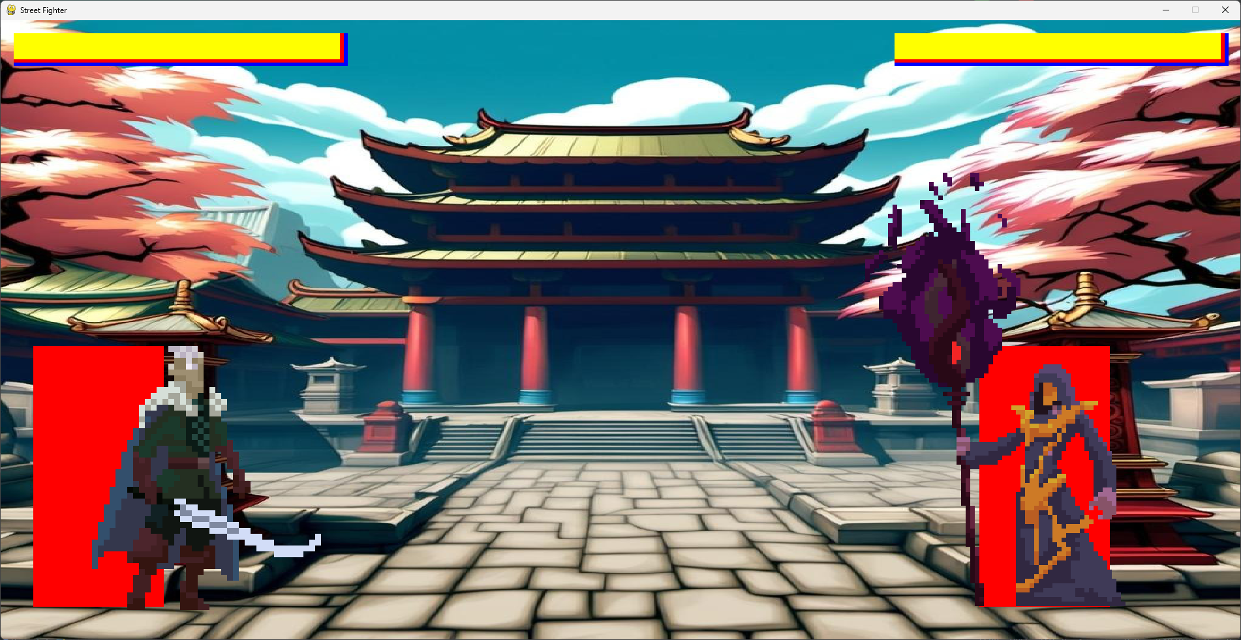
6] Screenshots

Slide 13
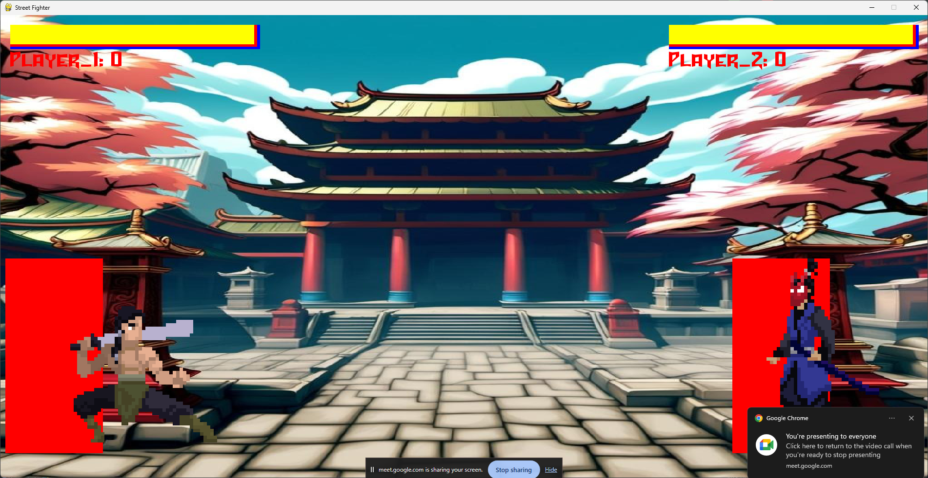
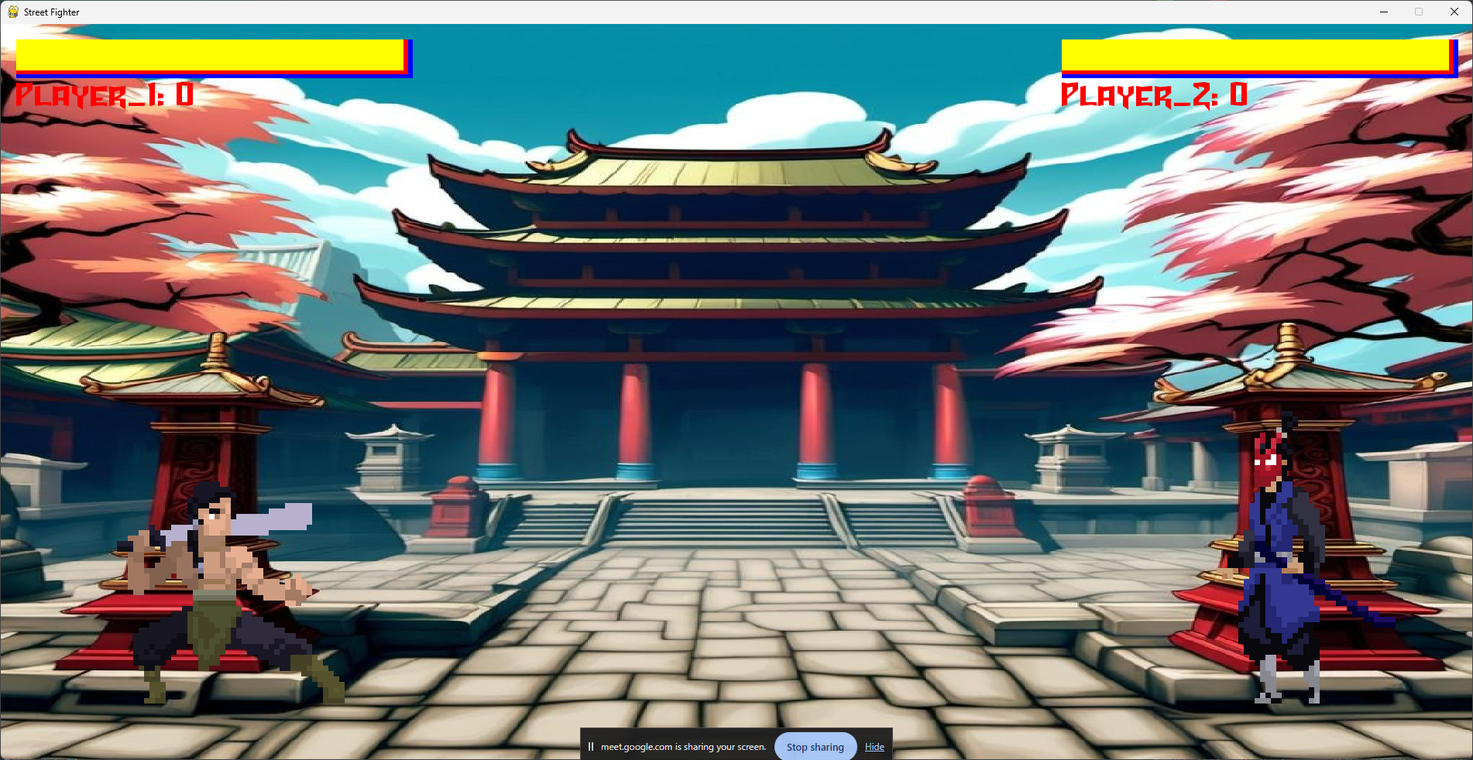
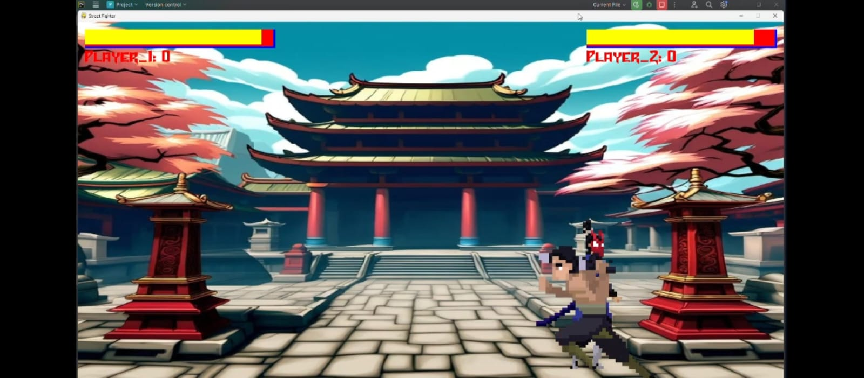

Screenshots

Slide 14
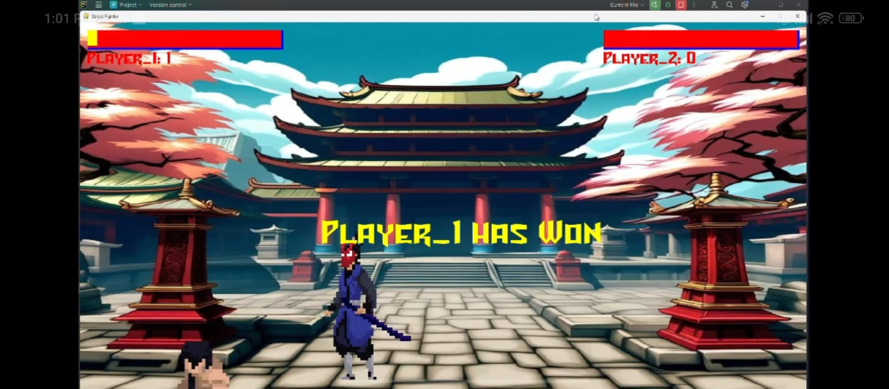
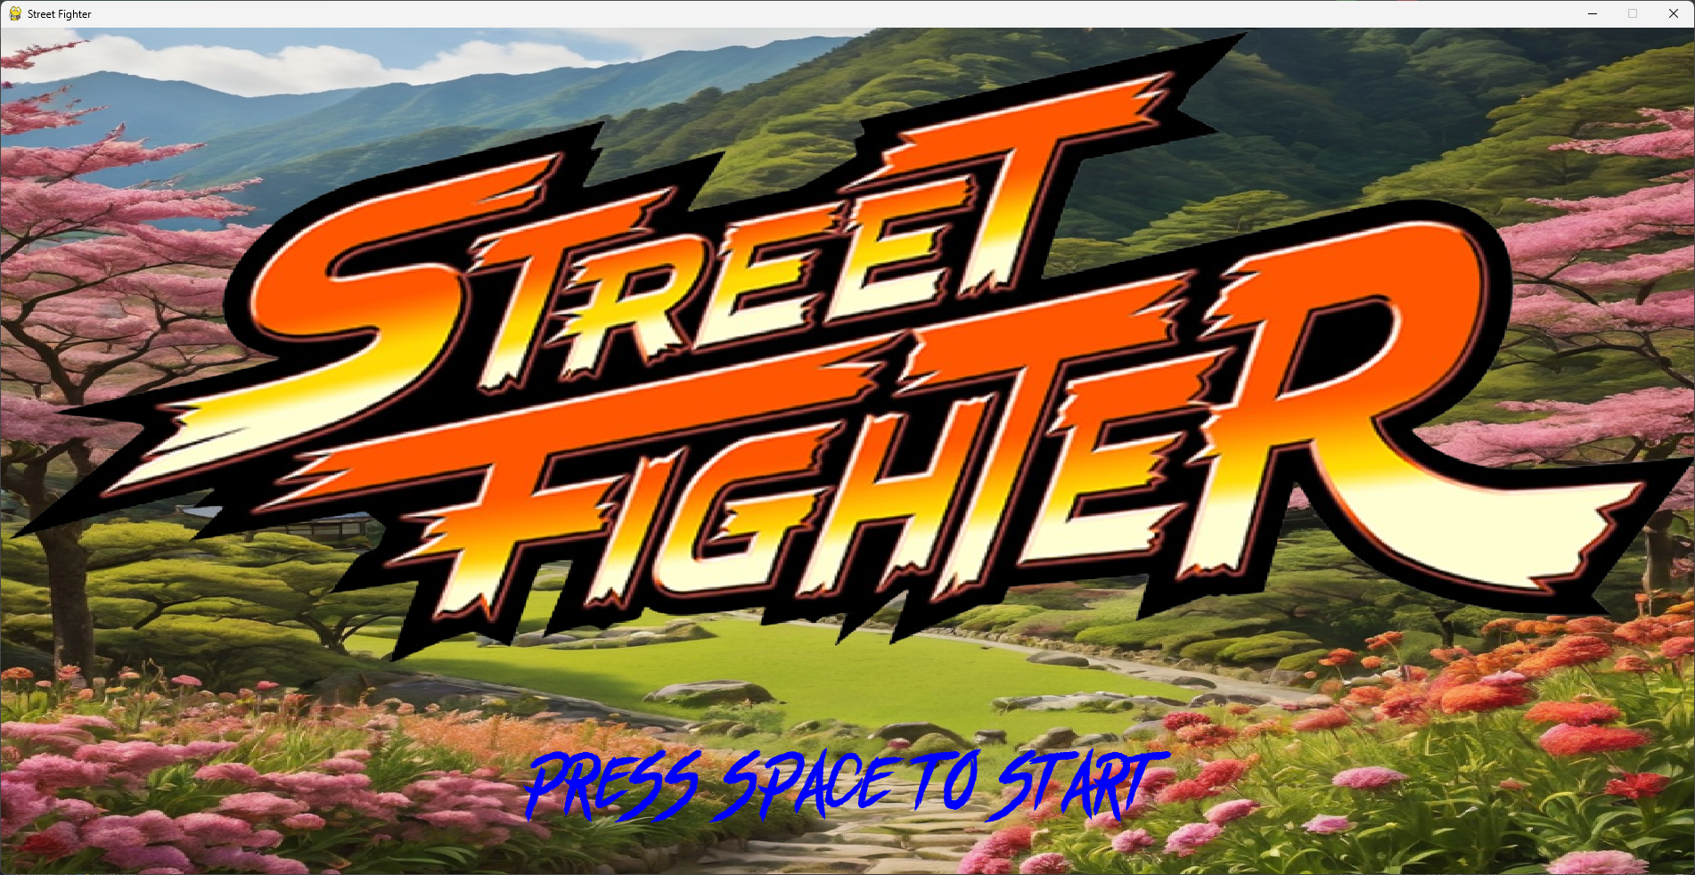
Screenshots

Slide 15
7] Conclusion
Python is a great language for game development, especially for beginners. It has a large and active community, and there are many libraries and frameworks available that make it easy to create games.
Game development is a journey filled with challenges and opportunities for creativity. Whether you're a seasoned developer or just starting out, the process of building a Street Fighter game in Python is sure to be both rewarding and educational.
That being said, Python is a great language for learning the basics of game development, and there are many successful games that have been created using Pygame.

